Slide 1
Photomicrographs of Plant foods
Cabbage
Permission to reproduce original photomicrographs used to make this collection may be obtained from
Dr. David O. Norris at
david.norris@colorado.edu

Slide 2
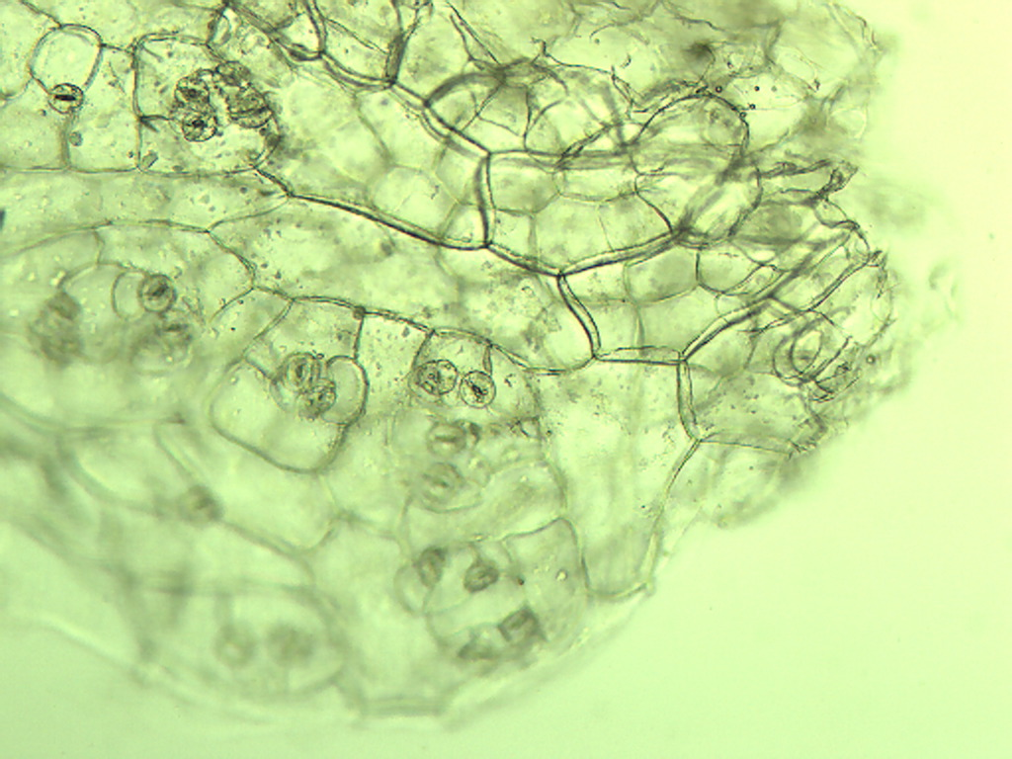
Notes:
108. Brassica oleacea L. var. capitata Cabbage, green. Epidermal cells of leaf with stomates (arrows), 10X.

Slide 3
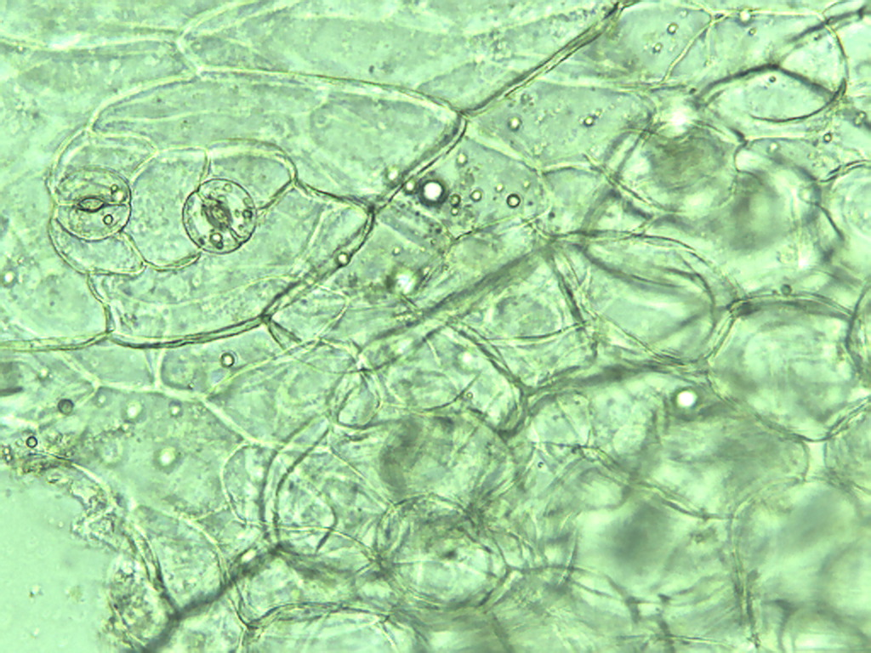
Notes:
109. Cabbage, green. Epidermal cells and stomates (arrows), 25X.

Slide 4
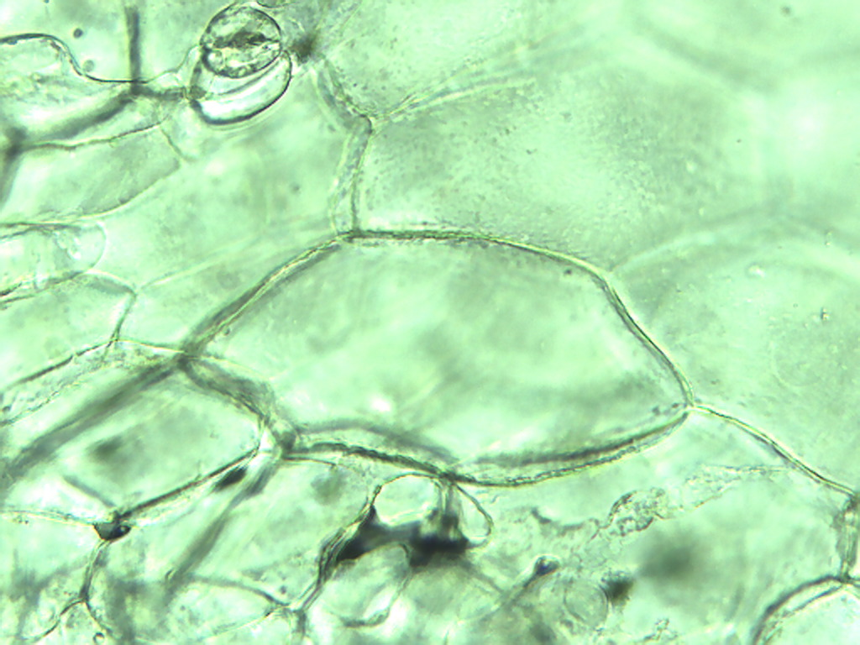
Notes:
110. Cabbage, green. Leaf epidermal cells, 25X.

Slide 5
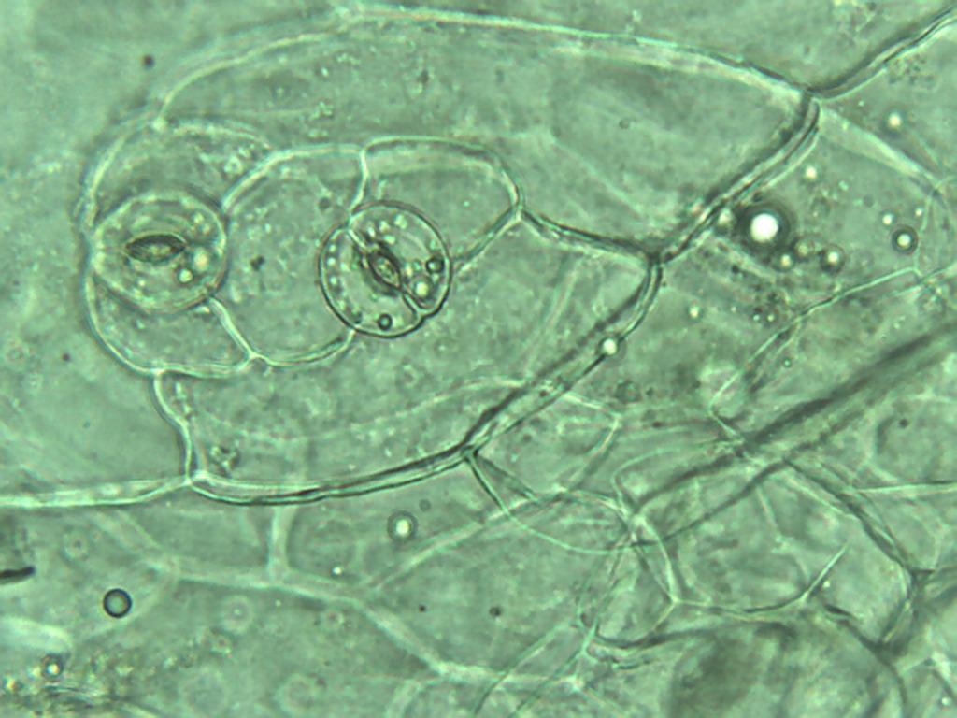
Notes:
111. Cabbage, green. Leaf epidermal stomates. Guard cell (arrow) with chloroplasts, 40X

Slide 6
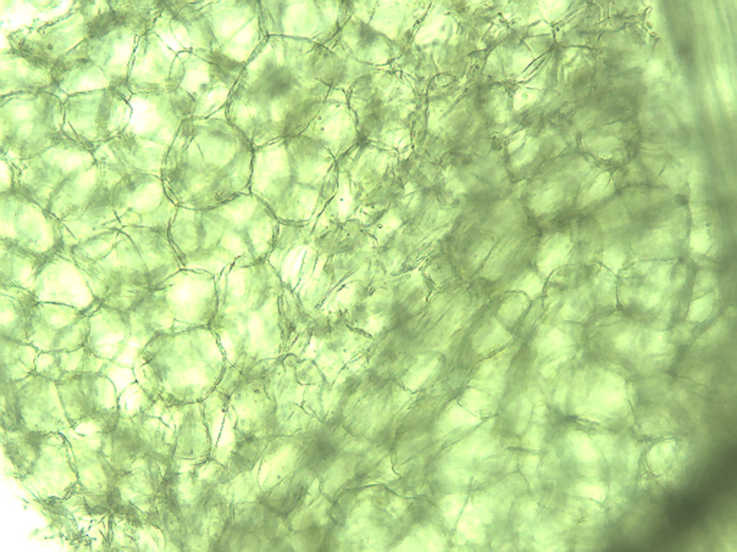
Notes:
112. Cabbage, green. Leaf parenchymal cells, 10X.

Slide 7
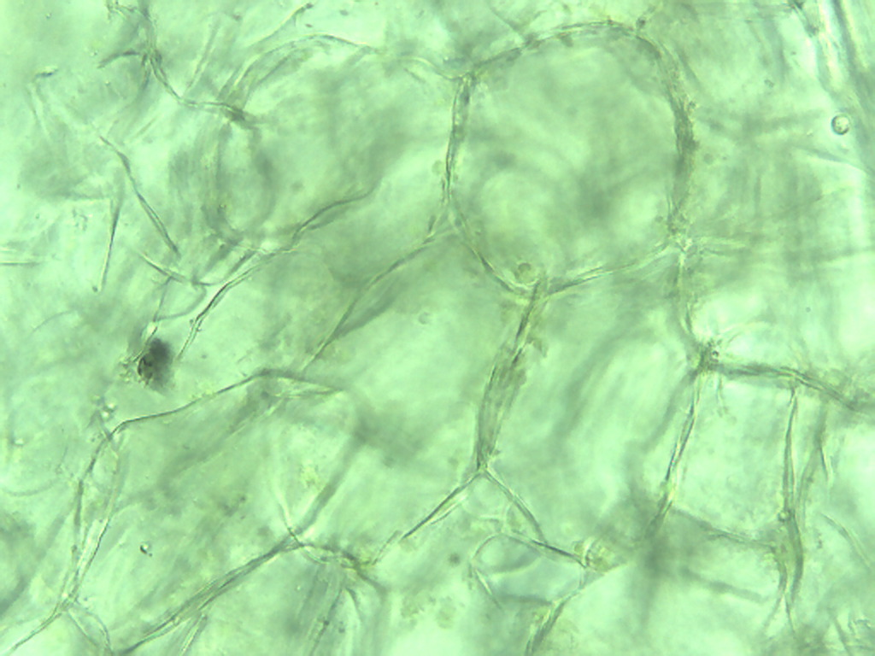
Notes:
113. Cabbage, green. Leaf parenchymal cells, 25X.

Slide 8
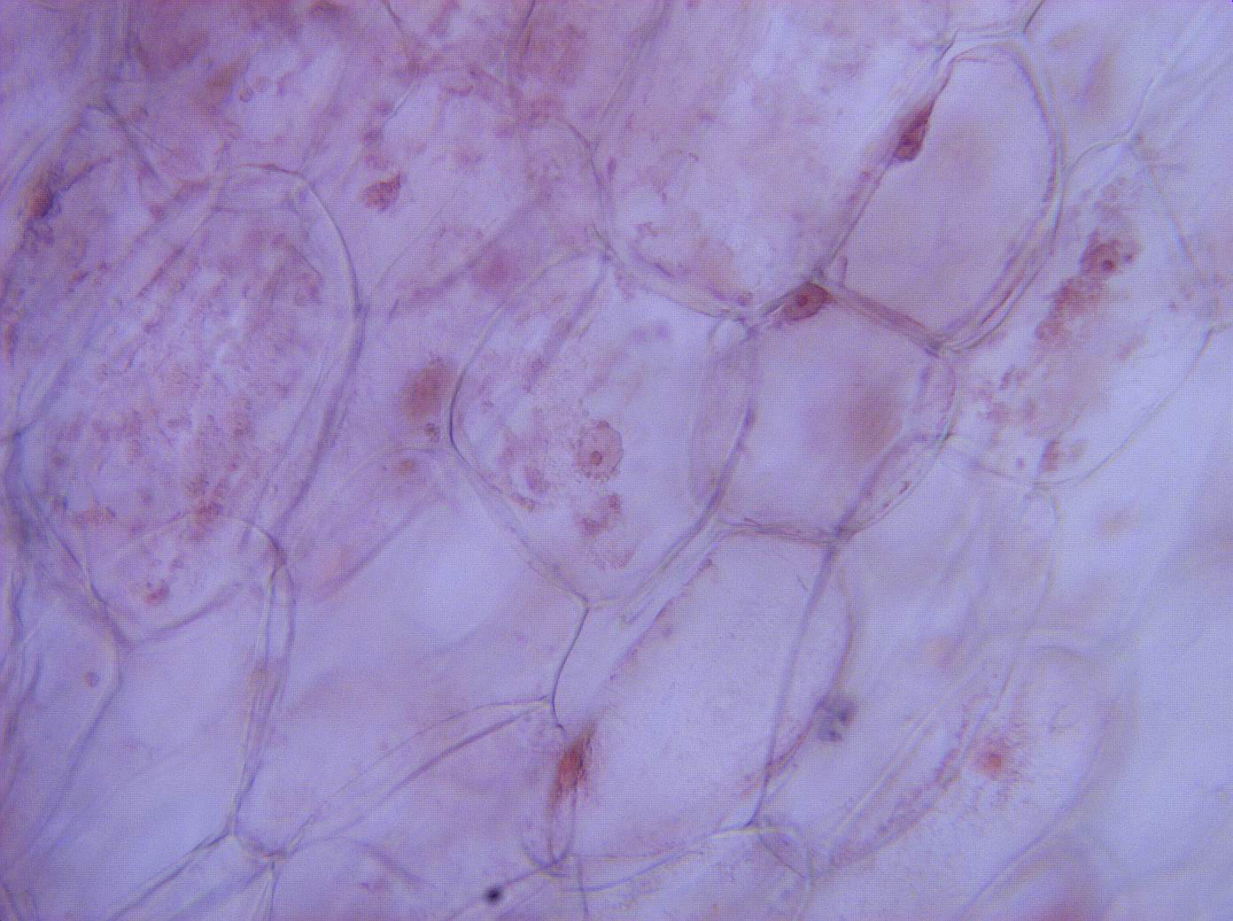
Notes:
114. Cabbage, red. Leaf parenchymal cells, stained with safranin, 25X.

Slide 9
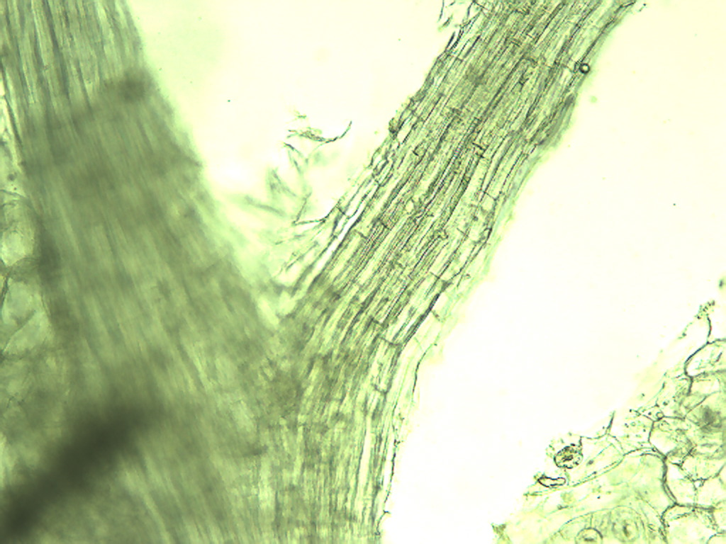
Notes:
115. Cabbage, green. Vascular tissue in leaf (small black arrow), epidermis fragment (large red arrow), 10X.

Slide 10
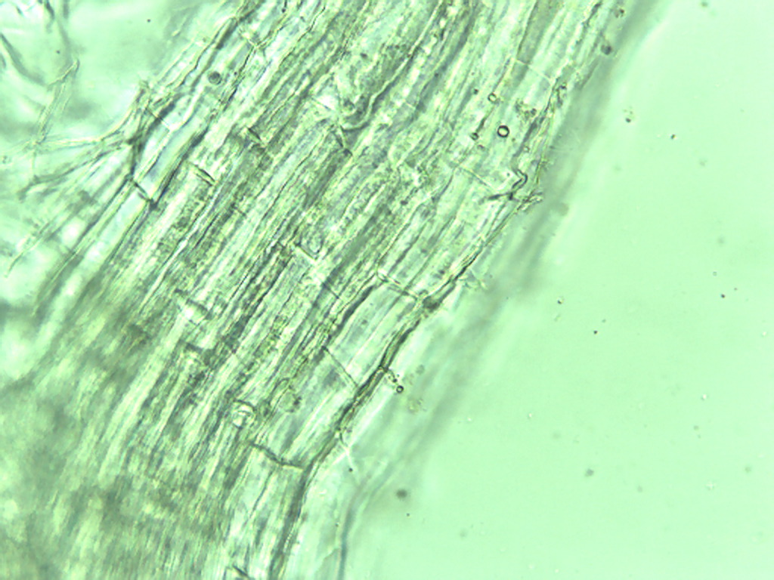
Notes:
116. Cabbage, green. Vascular tissue in leaf, 25X.

